Slide 1

BRAIN TUMOR CLASSIFIER
MRI SCANS CLASSIFIER

Slide 2
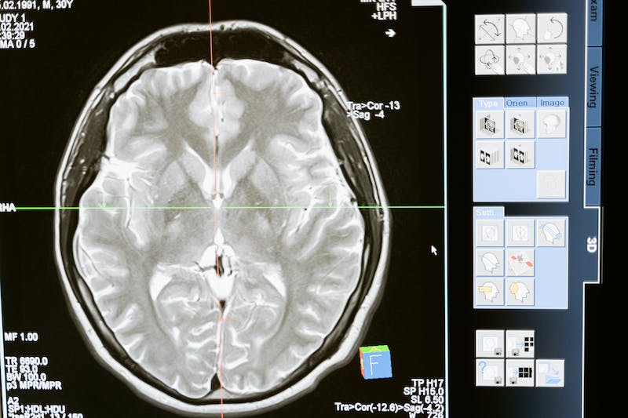
Table of contents
01
02
03
04
Data about our DATA
Review of our REVIEW 1
REVIEW 2
CONCLUSION

Slide 3


OBJECTIVE
To discern the presence of tumors from MRI scans, the classification involves three tumor types: Pituitary, Meningioma, and Glioma. Additionally, instances without tumors are also considered.

Slide 4

NEED FOR SUCH A CLASSIFIER
Maintains consistent performance regardless of factors like fatigue or time constraints, ensuring uniform evaluations.
Consistency
Machine learning classifiers enable unbiased analysis, recognizing intricate patterns in MRI data for precise tumor identification, minimizing human biases.
Pattern Recognition and Objective Analysis
Automated classifiers can analyze numerous scans swiftly, aiding in faster diagnoses and allowing for scalability in handling large volumes of data efficiently.
Scalability and Speed

Slide 5

01
Data about our DATA

Slide 6


DATA
KAGGLE LINK:
https://www.kaggle.com/datasets/sartajbhuvaji/brain-tumor-classification-mri/code
MRI SCANS

Slide 7
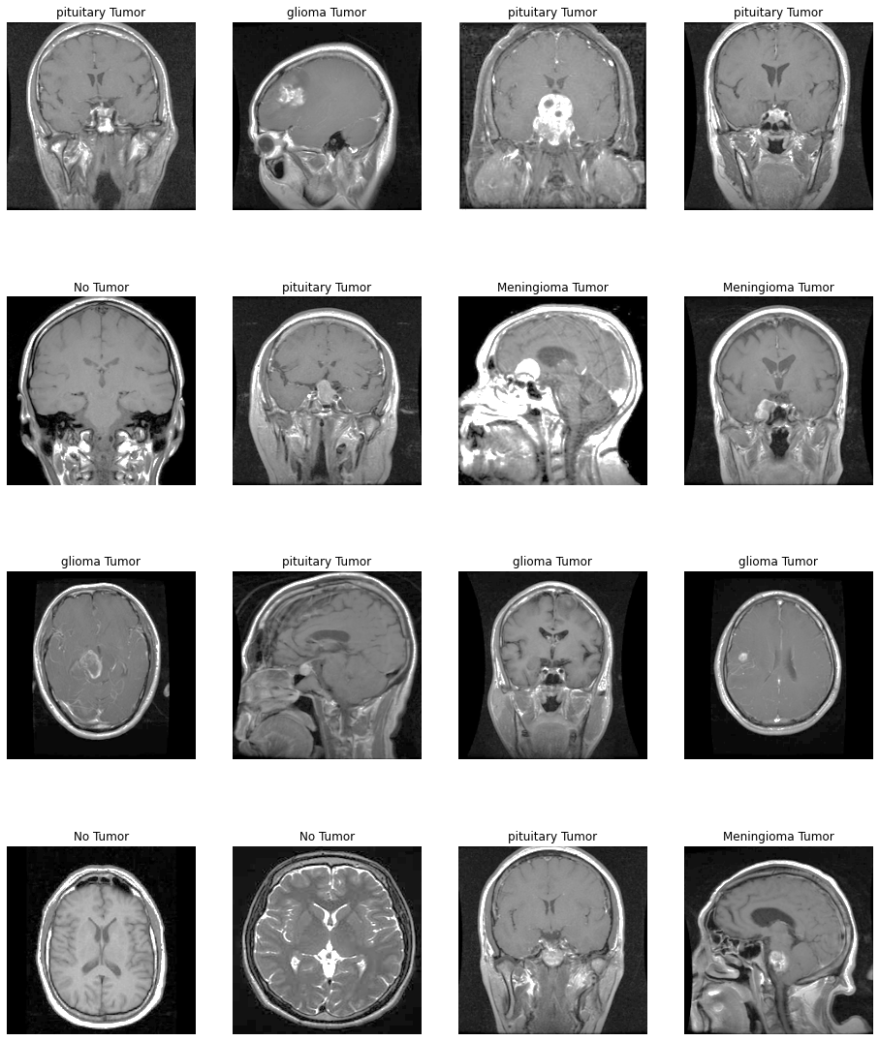
CLASS LABELS
Pituitary
Meningioma
Glioma
No tumor

Slide 8

THE PROBLEM??
150529
3160
COUNT OF COLUMNS
COUNT OF ROWS

Slide 9

SOLUTION
SMOTE->PCA
PCA->SMOTE
Preserves vital data, reduces noise, optimizes computation by downsizing pre-oversampling.
Manages complexity, captures diverse variance, focuses on balanced data post-oversampling.

Slide 10

RESULT
1K
1K
Approx COUNT OF COLUMNS
Approx COUNT OF ROWS

Slide 11

02
Review of our REVIEW 1

Slide 12
THREE MODELS
KNN
XGB
RFC
K-Nearest Neighbors (KNN) is a simple yet effective algorithm for classification and regression by assigning labels based on neighboring data points.
XGBoost (Extreme Gradient Boosting) is an optimized and scalable algorithm that improves upon gradient boosting, utilizing ensemble learning for accurate predictions.
Random Forest Classifier, an ensemble learning method, constructs multiple decision trees and aggregates their outputs to provide robust and accurate classifications.

Slide 13
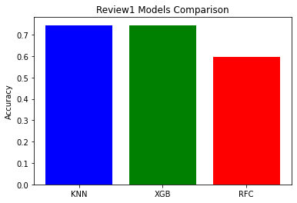
Our statistics
Understanding the numbers
ONE METRIC COMPARISON.
EQUAL ACCURACY IS SHOWN BY KNN AND XGB.
BUT, IS IT TRUE FOR ALL METRICS?

Slide 14
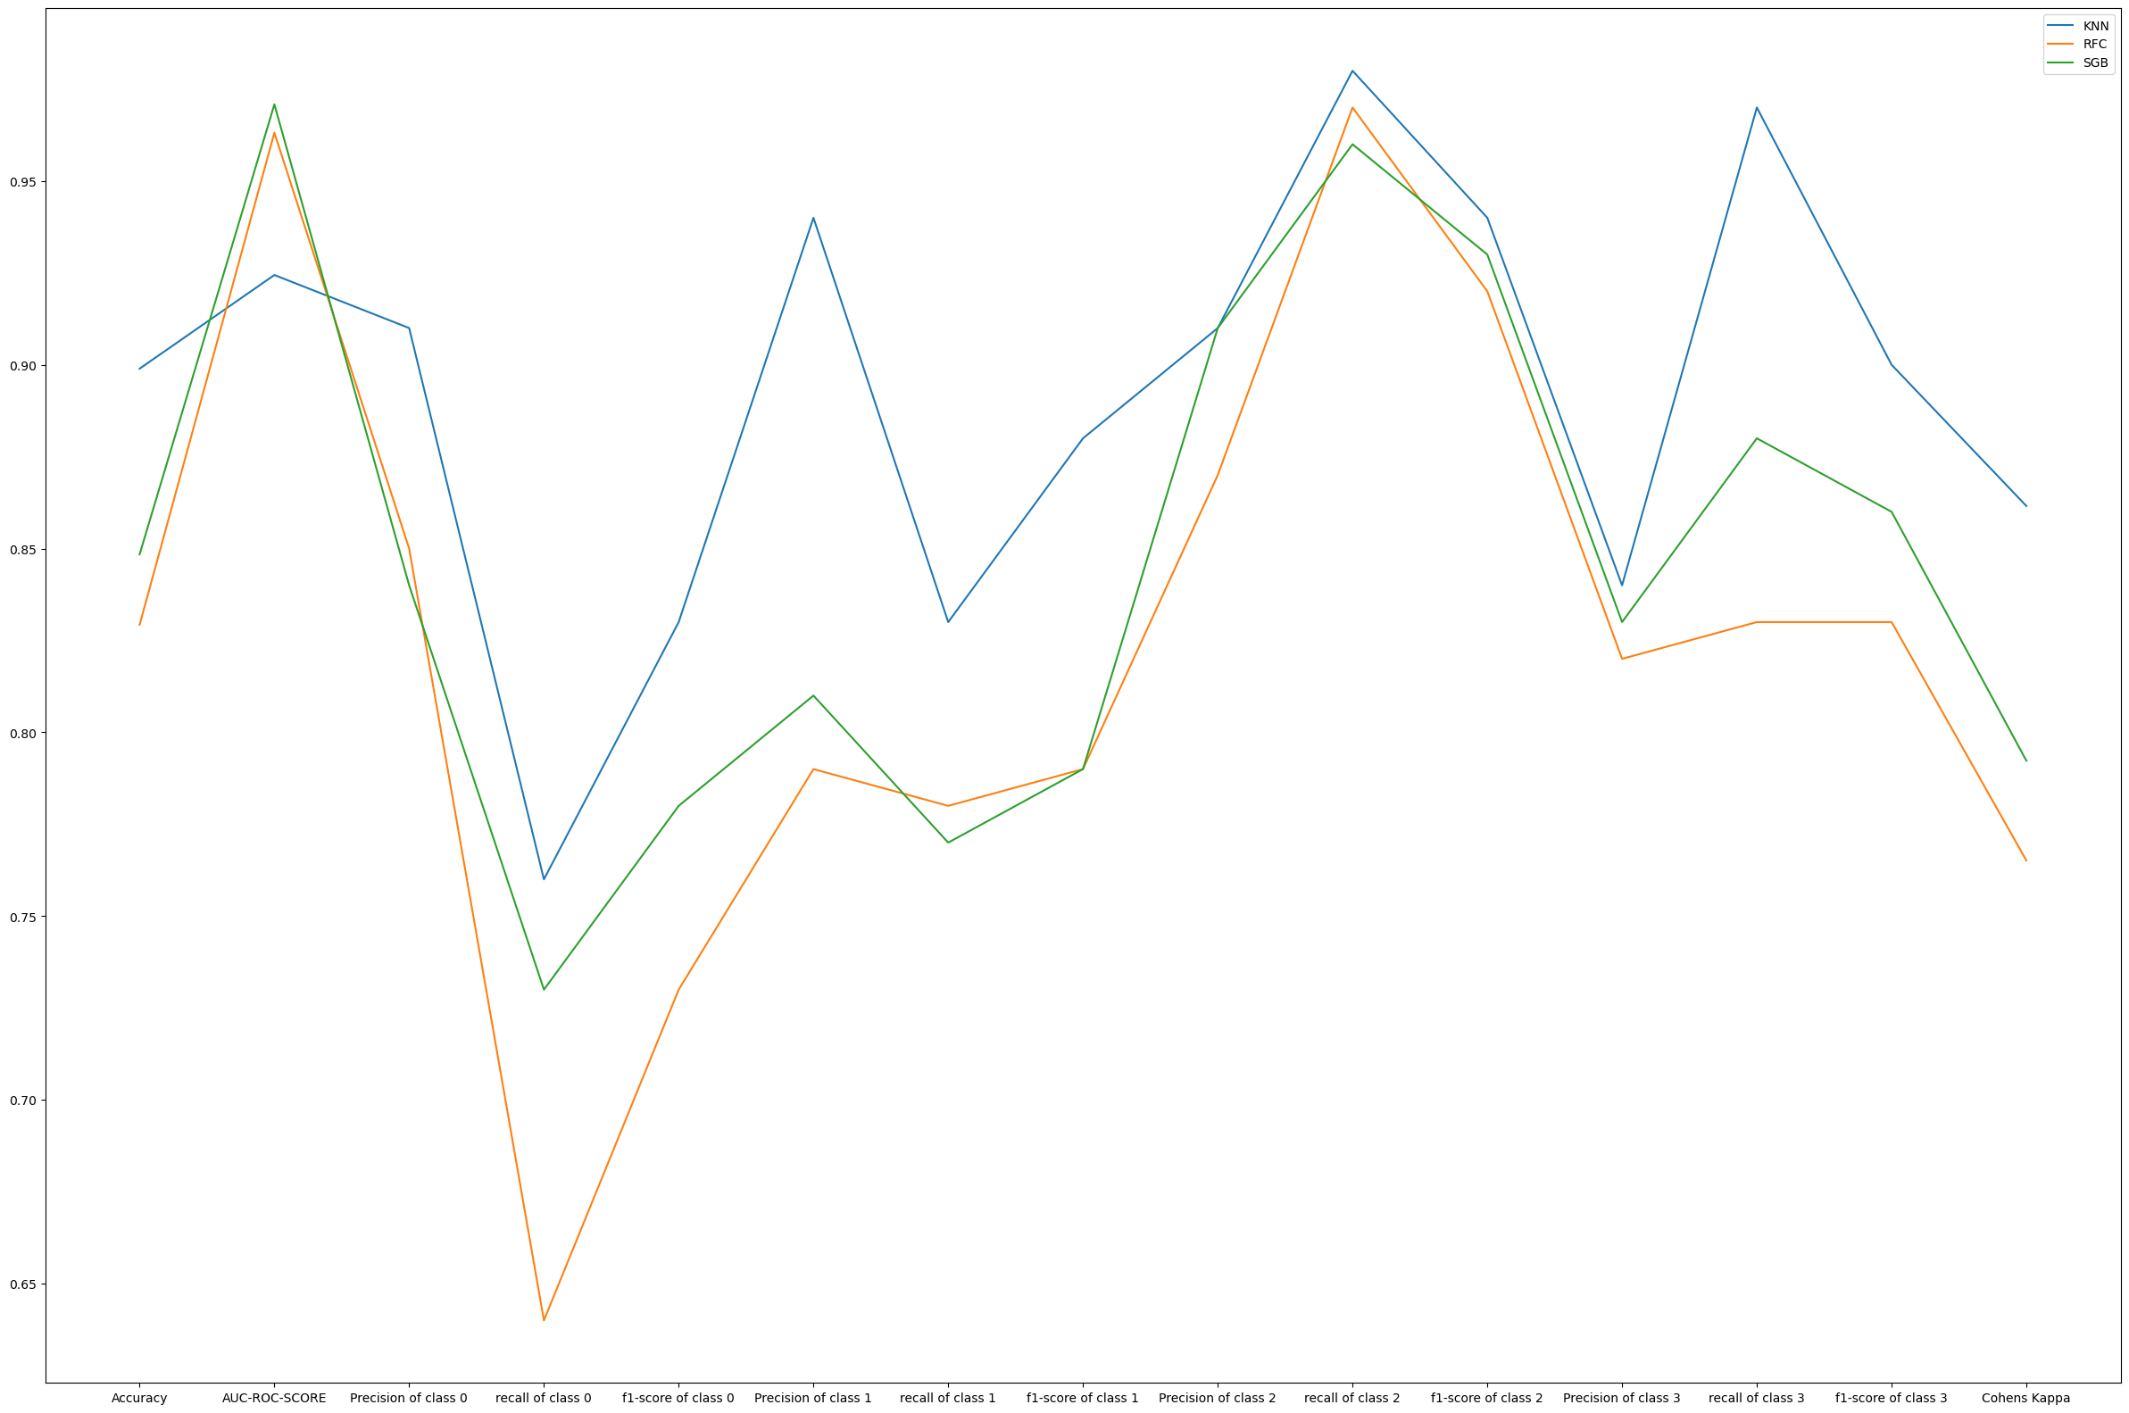
~90%
KNN won!

Slide 15

03
REVIEW 2

Slide 16
PROBABILISTIC MODELS
NAÏVE BAYES
GAUSSIAN
LOGISITIC REG
Naive Bayes, based on Bayes' theorem, assumes independence between features, offering simplicity and efficiency for classification tasks with modest data.
Gaussian Process relies on probabilistic modeling, predicting distributions over functions, beneficial for small datasets, providing uncertainty estimates, and handling non-linear relationships.
Logistic Regression, a linear model, predicts probabilities for binary classification by mapping features to the sigmoid function, offering interpretability and ease of implementation.

Slide 17
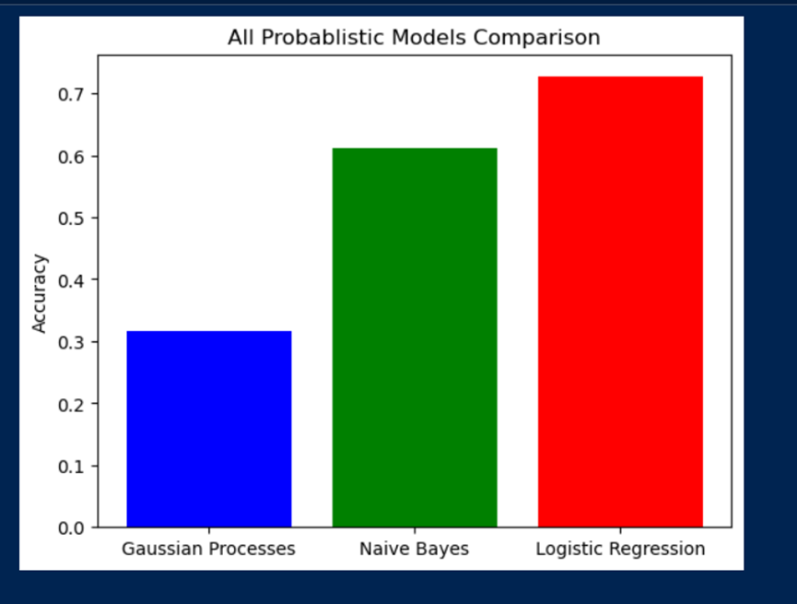
Our statistics
Understanding the numbers
ONE METRIC COMPARISON.
HIGHER ACCURACY IS SHOWN BY LR.
BUT, IS IT TRUE FOR ALL METRICS?

Slide 18
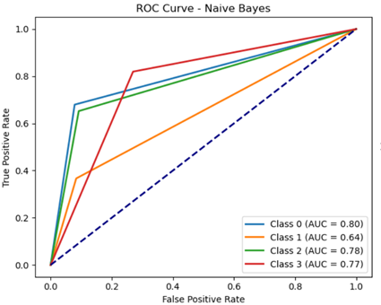
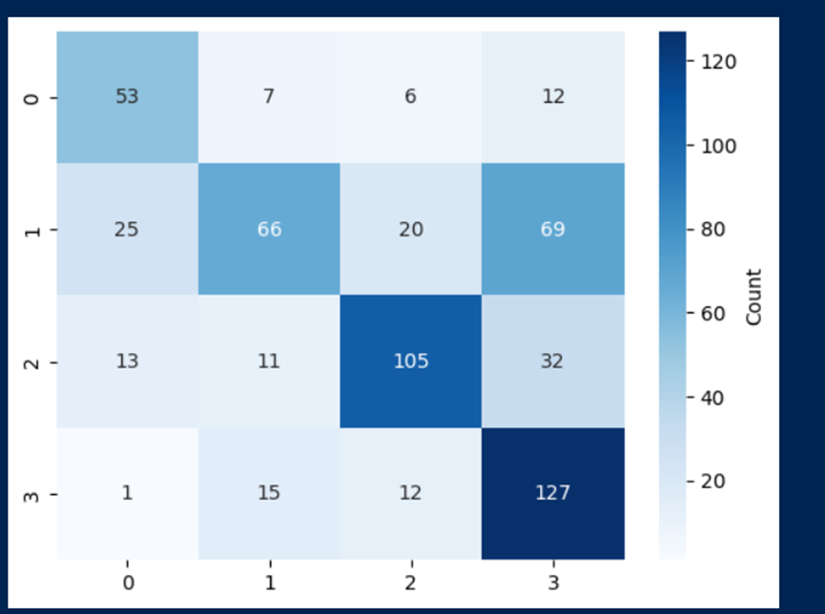
NAÏVE BAYES

Slide 19
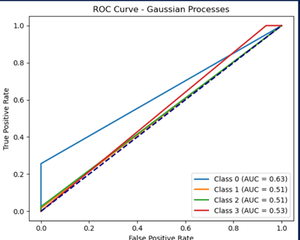
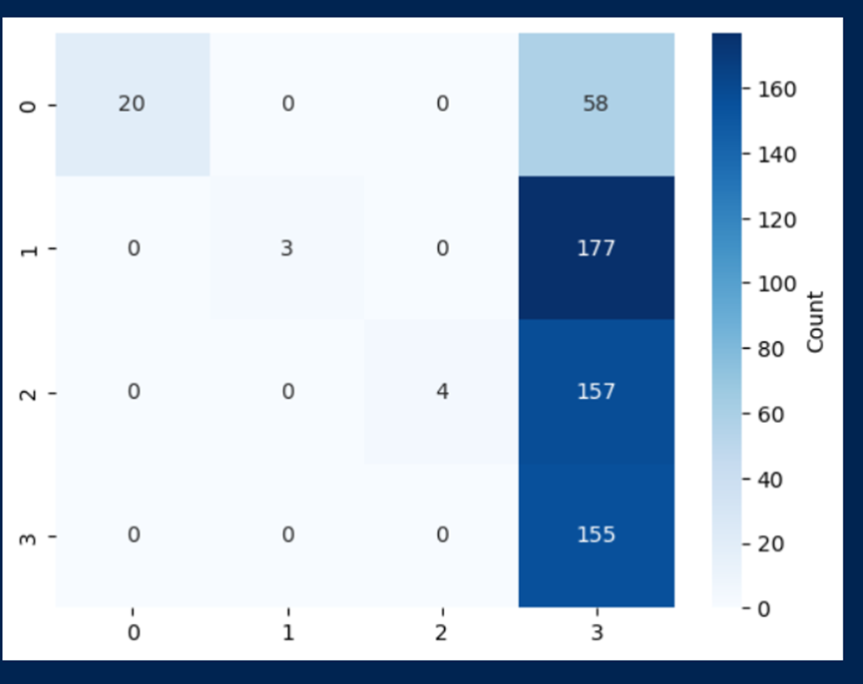
GAUSSIAN
PROCESS

Slide 20
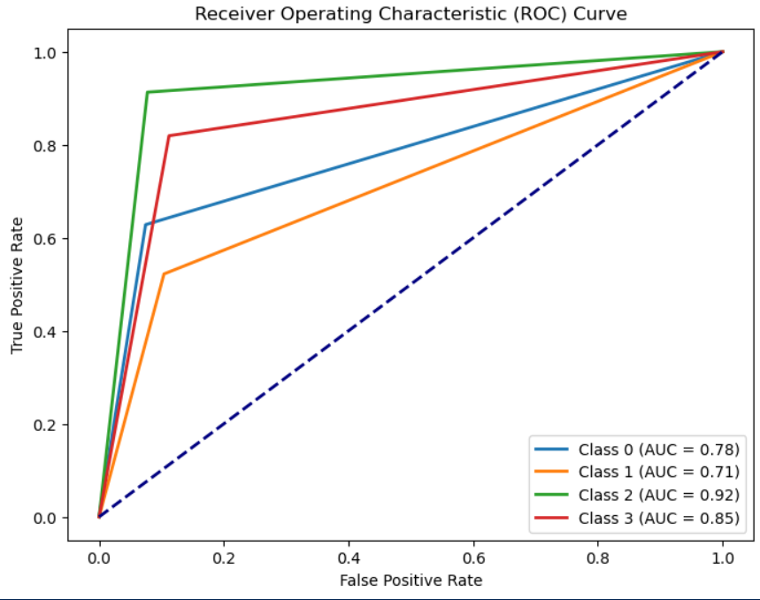
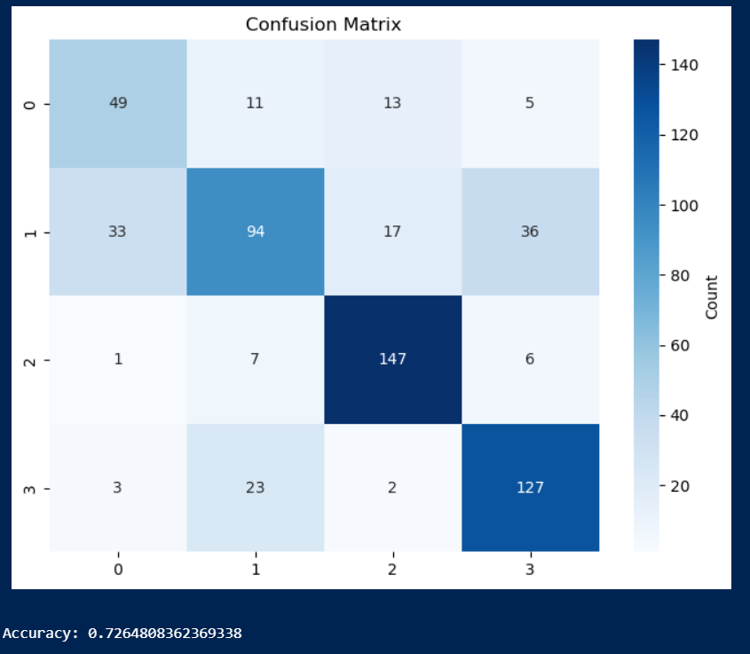
LOGISTIC
REGRESSION

Slide 21
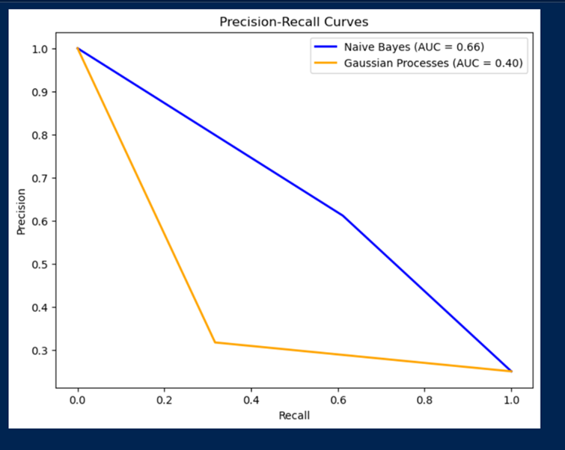
AND MORE

Slide 22
UNSUPERVISED MODELS
K MEANS
DB SCAN
K-Means partitions data into 'k' clusters by minimizing within-cluster variance, suitable for well-separated, spherical clusters, but sensitive to initialization.
DBSCAN identifies clusters based on density, adept at finding arbitrary shapes, handling noise, and varying cluster sizes, not requiring predefined cluster count.

Slide 23
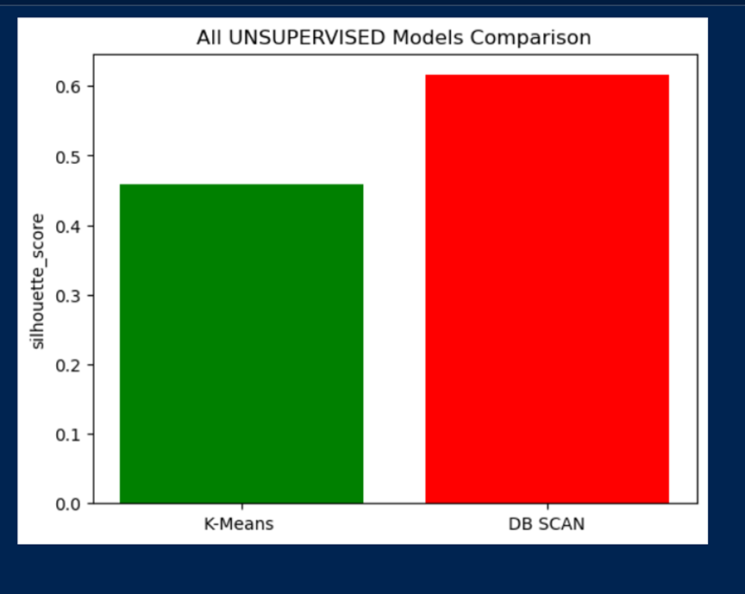
Our statistics
Understanding the numbers
ONE METRIC COMPARISON.
HIGHER ACCURACY IS SHOWN BY DB SCAN!

Slide 24
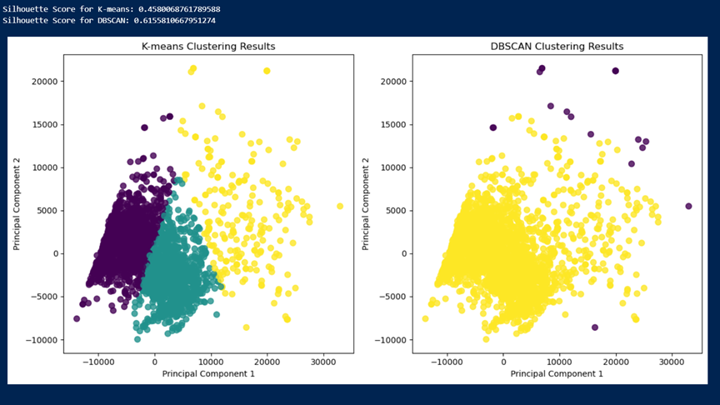
AND MORE

Slide 25
ENSEMBLE MODELS
ADA BOOST`
BAGGING
AdaBoost, an ensemble method, combines weak learners to create a strong classifier by sequentially adjusting weights, focusing on misclassified instances.
Bagging model aggregates predictions from several models, reducing variance by bootstrapping data and averaging predictions, minimizing overfitting for enhanced generalization.
GRADIENT BOOSTING
STACKING
Gradient Boosting incrementally improves models, minimizing errors using a sequence of weak learners, adjusting based on residuals, reducing bias and variance.
Stacking model combines multiple classifiers to blend predictions, employing a meta-learner for final predictions, enhancing overall performance via diverse model aggregation.

Slide 26
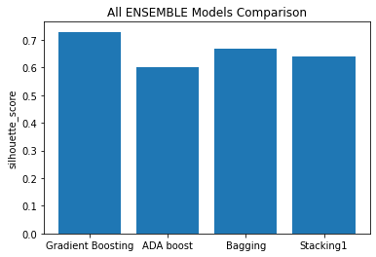
Our statistics
Understanding the numbers
ONE METRIC COMPARISON.
HIGHER ACCURACY IS SHOWN BY GRADIENT BOOSTING!

Slide 27
AND MORE

Slide 28

04
CONCLUSION

Slide 29
THE ULTIMATE BATTLE!

Slide 30
Our statistics
Understanding the numbers
ONE METRIC COMPARISON.
HIGHER ACCURACY IS SHOWN BY KNN!

Slide 31
CONGRATULATIONS KNN!

Slide 32
FINDINGS
PROBABILISTIC MODEL DIDN’T GIVE APPROPRIATE RESULTS ON OUR DATA!
HIGH-LEVEL COMPUTATIONAL-POWERED ALGORITHMS GAVE A TOUGH FIGHT TO NEURAL!
HIGH TIME CONSUMING!
HYPERPARAMETER TUNING TOSSED OUR RESULTS TO BOTH EXTREMES!!

Slide 33
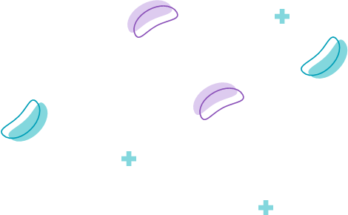
++
UI TIME!

Slide 34


Slide 35
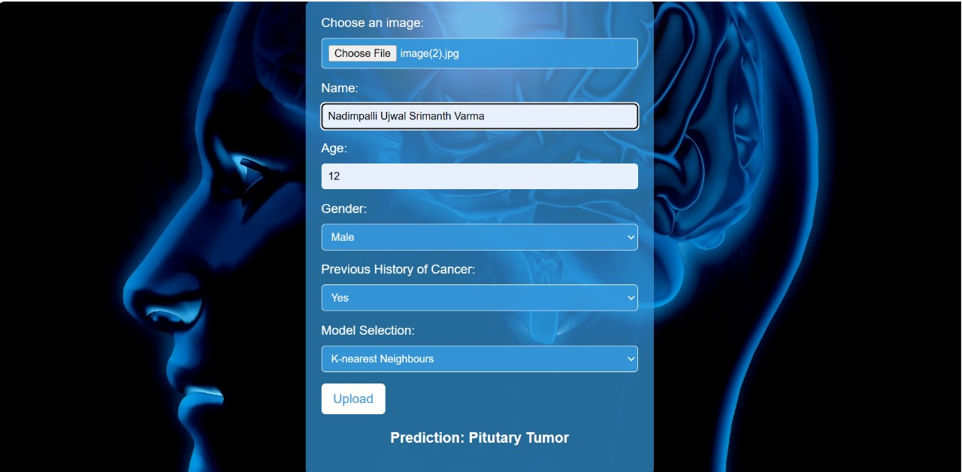

Slide 36


Slide 37
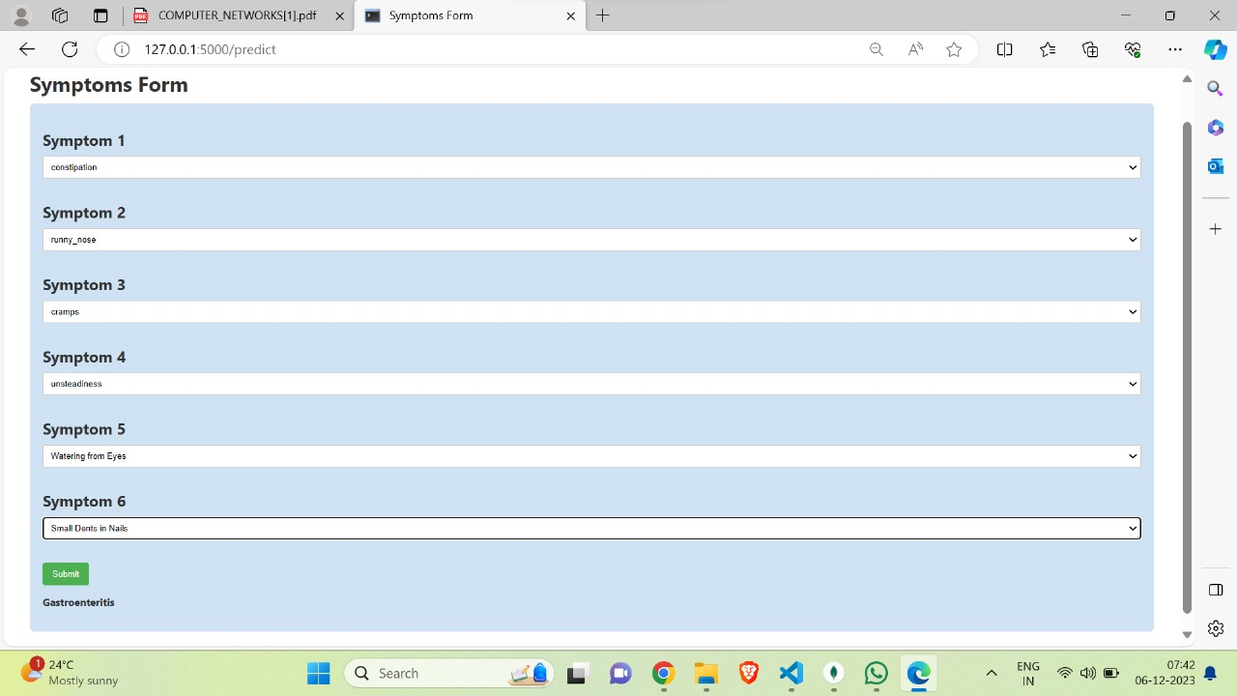

Slide 38
Thanks!
STILL HAVING QUERIES?
Shoot at us right away!

